Slide 1
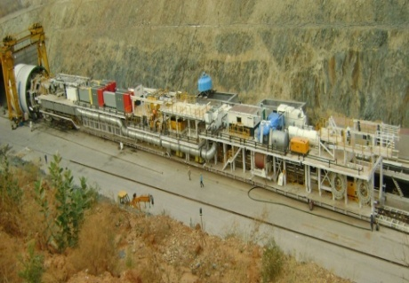
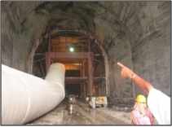
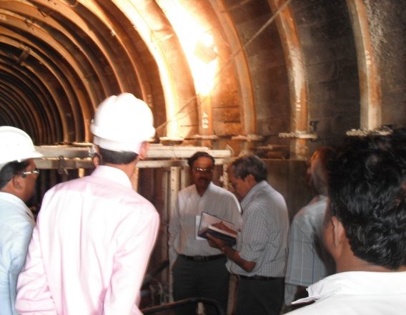
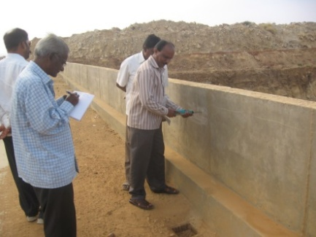
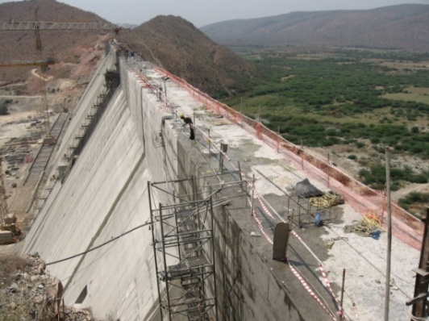
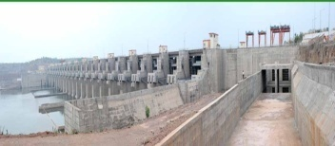
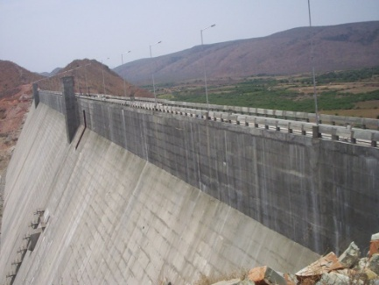
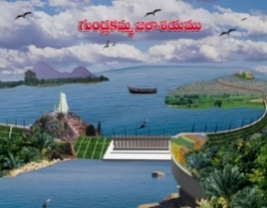
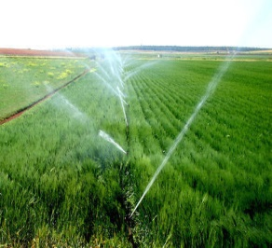
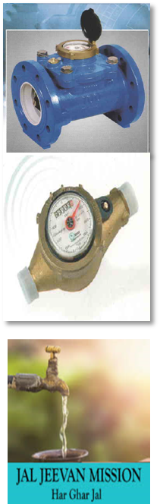
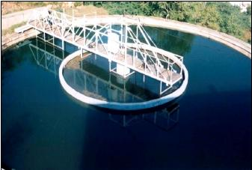
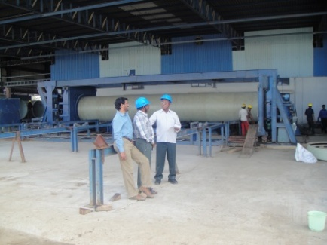
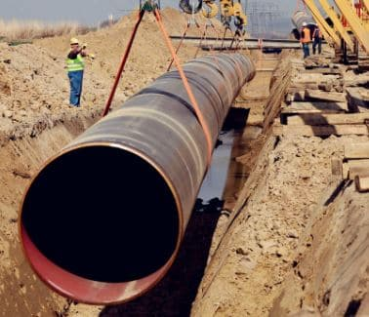
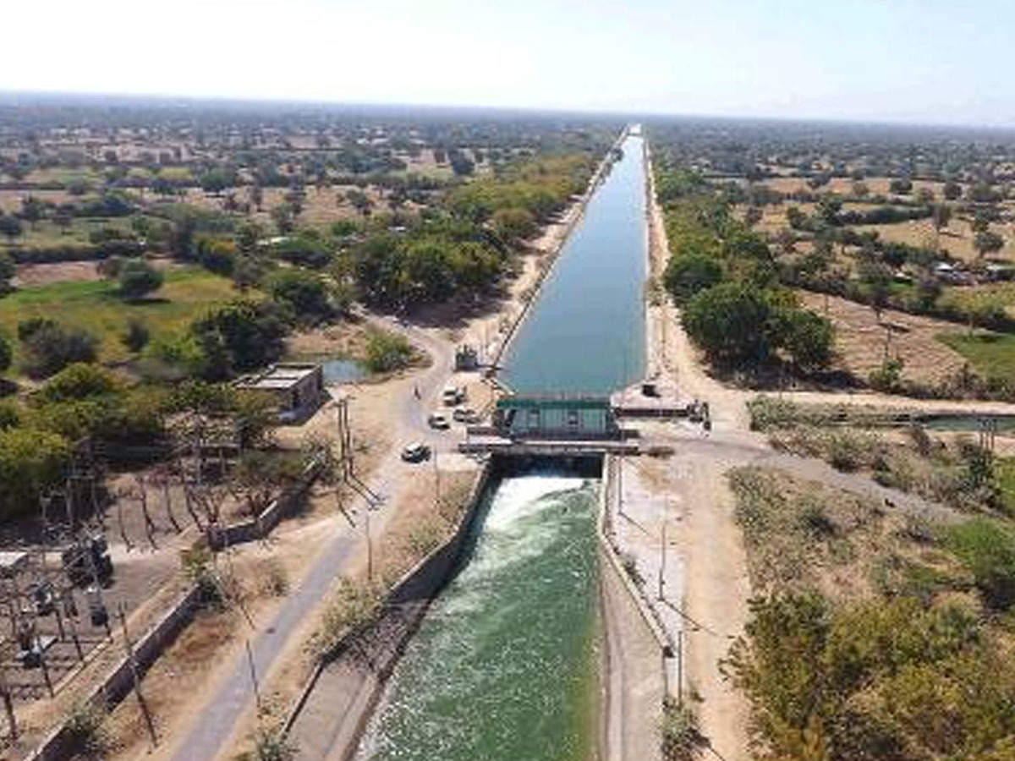
Transwat Techno-Engineering Services Ltd
[ Formerly Wadia Techno-Engineering Ltd ]
(Est. in 1960)
(WATER RESOURCES DEVELOPMENT SECTOR PROFILE)
Design / Project Management Consultants for Highways, Bridges, Elevated Roads - Buildings (Commercial, Industrial, Institutional Buildings etc;)
- Major Irrigation (Reservoirs, Dams, Tunnels, Lift Irrigation, Canals) - Smart Cities - Water Supply - Industrial Parks - Logistic Parks
Regd. Office:
A-201, Upsahra lane, Shree Arham Bluz, C D Barfiwala Cross Lane, Andheri (W) , Mumbai - 400058.
Tel : 022- 44545653; 98858 09317 Email : bd@transwat.com ; www.transwat.com

Slide 2



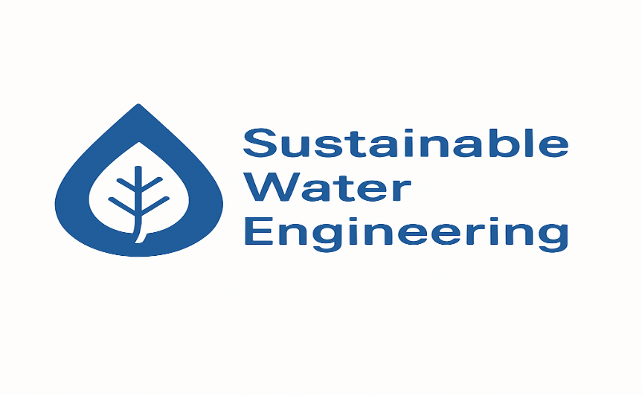
Comprehensive Consultancy Services in the Water Sector
We offer end-to-end engineering and project management consultancy services across the entire water infrastructure spectrum.
With a rich legacy since 1960 and pan-India expertise, we specialize in :
💧 Our Core Water Sector Services
🚰Urban & Rural Water Supply Systems
End-to-end planning, network modeling (EPANET, WaterGEMS), hydraulic design, and DPR preparation under JJM and other schemes.
🛠️Major & Minor Irrigation Projects
Dams, reservoirs, canals, tunnels, lift irrigation schemes with complete design review, technical audits, and PMC.
🌧️Storm Water Drainage & Sewerage Networks
Sustainable urban stormwater design, sewage treatment, pumping stations, and underground infrastructure systems.
🌊Reservoir & Canal Engineering
Geotechnical studies, alignment planning, hydraulic calculations, and structural detailing.
🌾Micro & Lift Irrigation Systems
Piped irrigation networks, pump houses, intake structures, and energy-efficient design optimization.
🧪Environmental & Hydraulic Modeling
Feasibility studies, social and environmental assessments, water resource optimization, and green infrastructure.
🏗️Project Management Consultancy (PMC)
Cost, time & quality management for large-scale water sector projects — from design review to execution supervision.
PAN-INDIA PRESENCE & EXPERIENCE
PROVEN TRACK RECORD
Transwat Techno-Engineering Services Ltd

Slide 3
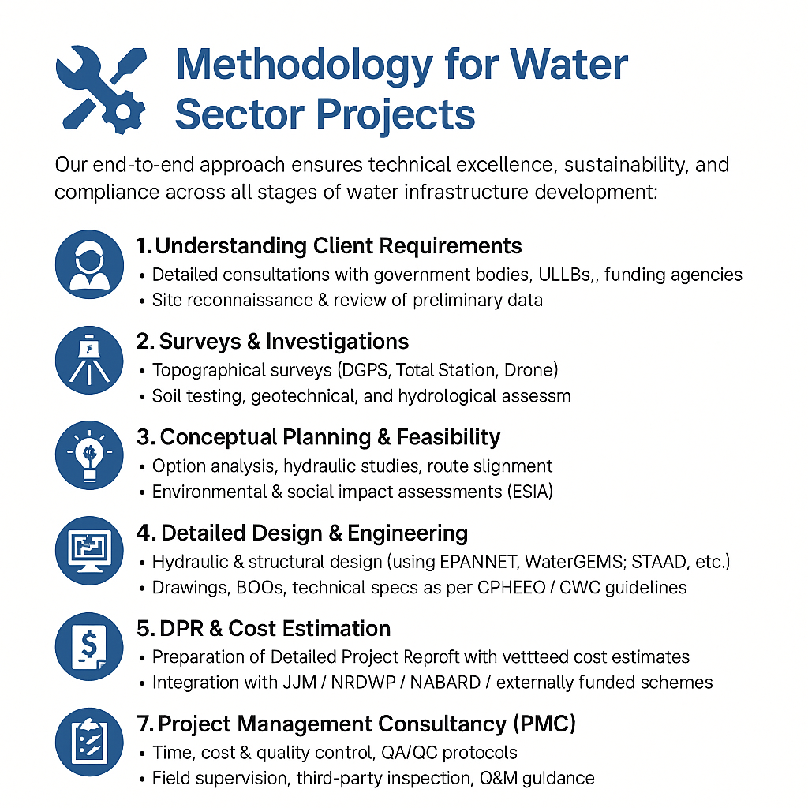
Methodology
Transwat Techno-Engineering Services Ltd

Slide 4

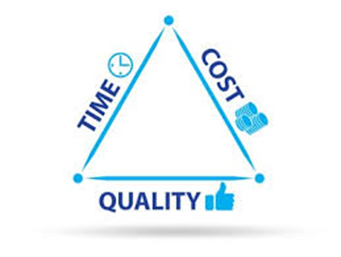
Key Advantages
🌟 Sector-Specific Expertise
Deep understanding of hospitality & entertainment project dynamics
Proven experience across luxury hotels, resorts, multiplexes, and leisure zones
📈 Time Optimization & Cost Control
Realistic planning, fast-track execution, and cost-saving interventions
Minimized delays through proactive monitoring and agile adjustments
🧩 Seamless Coordination
One-stop interface for client, architect, contractors & vendors
Effective management of multi-stakeholder inputs and approvals
🛡️ Quality Assurance & Risk Mitigation
Robust QA/QC protocols and periodic audits
Early detection of risks and structured mitigation strategies
🔍 Transparent Reporting & Control
Real-time dashboards, MIS reports & escalation protocols
Full visibility into progress, bottlenecks, costs & timelines
🚀 Operational Readiness Support
Handover, licensing, pre-opening coordination, and facility readiness
Support in branding, interiors, and guest experience enhancement
Transwat Techno-Engineering Services Ltd

Slide 5
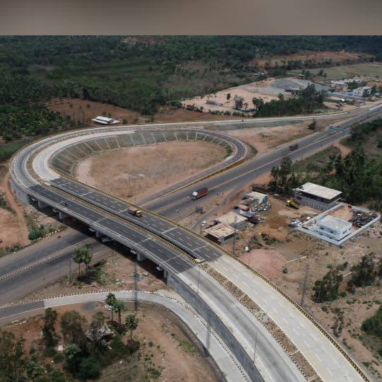
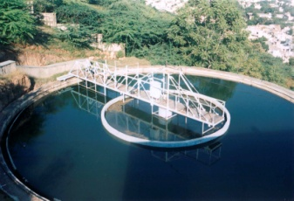
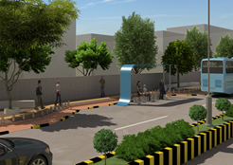
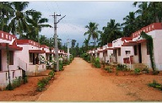
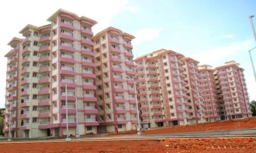
ABOUT TRANSWAT TECHNO-ENGINEERING SERVICES LTD
Wadia Techno Engineering Services Limited, (WTE), est. 1960, Mumbai, has Completed consultancy for various projects on Pan India, in varied sectors, viz., Transportation, Water, Buildings, Urban Engineering, Urban Development, Industrial, Logistics, Smart Cities Projects etc, spreading in several States such as Gujarat, Maharashtra, Rajasthan, Uttar Pradesh, Haryana, Punjab, Andhra Pradesh, Telangana, Karnataka, Tamilnadu, Odisha, West Bengal, North Eastern States, and so on.
Transportation - Highways, Expressways, Elevated Roads, Fly over / ROBs, Major Bridges, City Smart Roads, Rigid Pavements, Logistic Parks, Utility Shifting Projects etc;
Minor Irrigation, Major Irrigation Projects viz., Dams, Reservoirs, Canals, Tunnels, Lift Irrigation etc,
Water Supply (Urban . Rural), Sewerage, Storm Water & associated infrastructure etc,
Urban Planning, Engineering, and Development from Concept to completion, including extensive Urban Engineering Services for Water and Sanitation, Roads, Utilities, revamping of existing infrastructure & systems, Smart City Projects, Development of Parks, Environmental related Projects, etc;
Buildings - Institutional such as Corporate Offices, University Buildings, Buildings for IITs, Medical College Campuses, Law College etc, Commercial Constructions, Multiplex Industrial Constructions, Residential Accommodations, Hospitals, Five Star Hotels, Recreational Infrastructure, Religious projects, and etc.
Industrial Estate Development, SEZ, Industrial Parks, IT Park, Electronics Park, Textile Park, and etc;
Property Development Projects, etc,
Successfully completed consultancy for BOT / PPP Projects as also for various externally funded projects such as World Bank Projects, ADB Projects etc.
Transwat Techno-Engineering Services Ltd

Slide 6
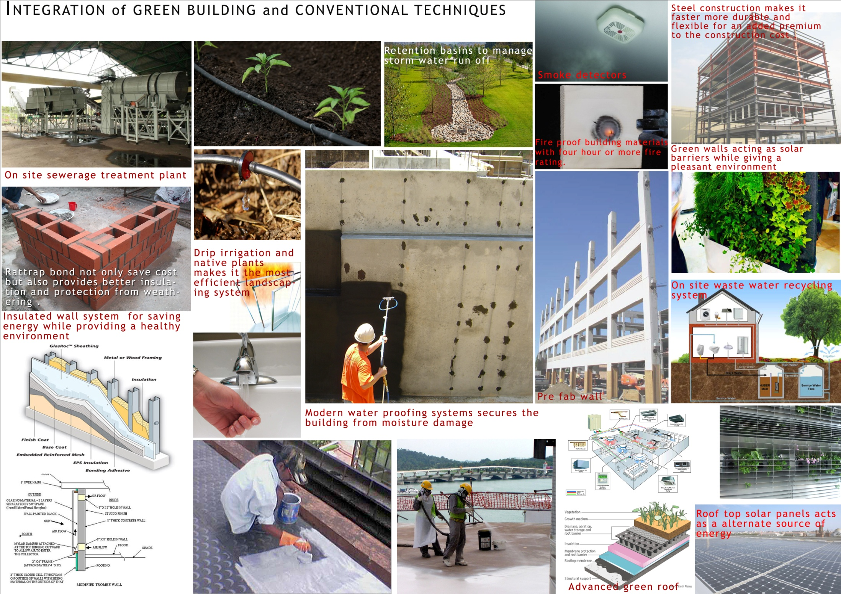
GREEN RECOMMENDATIONS as IGBC Founder Member
Transwat Techno-Engineering Services Ltd

Slide 7
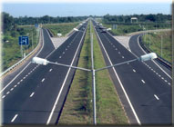
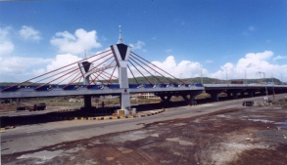
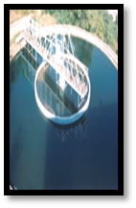
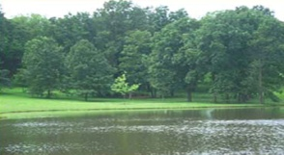
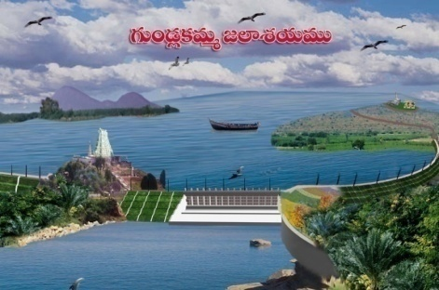

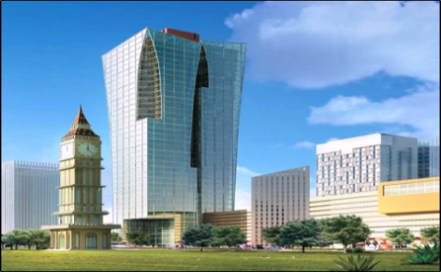
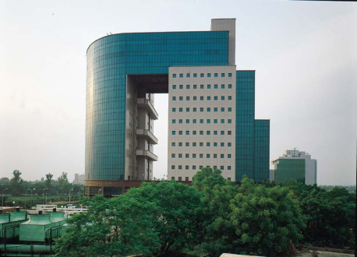
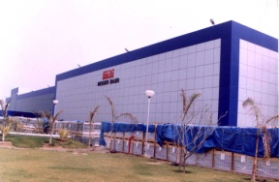
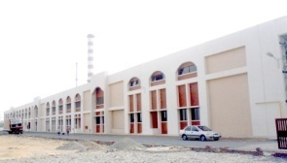
Consultancy Services – Infrastructure and Industrial Projects
Preparation of Plan(s), Detailed Design Engineering, Drawings, BOQs and Estimates, Tendering process, Bid Evaluation, Project Management Consultancy, Third Party Quality Control / Assurance, Value Engineering, Technical Audit
Highways, Major Bridges, Elevated Roads
Water and Sanitation
Minor and Major Irrigation
Smart Cities
SEZs, Industrial Parks, IT Parks
Industrial Projects
Transwat Techno-Engineering Services Ltd

Slide 8
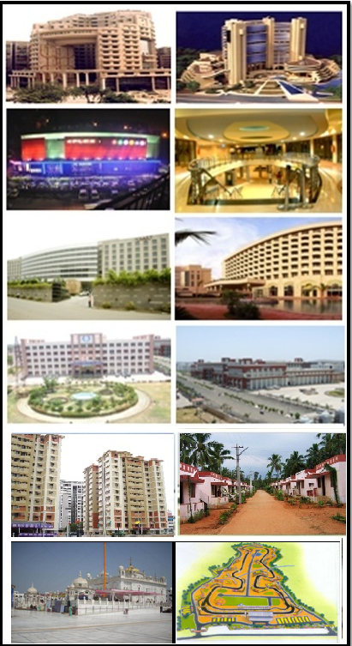
Consultancy Services –Commercial, Residential Buildings and other sectors
Preparation of Plan(s), Detailed Design Engineering, Drawings, BOQs and Estimates, Tendering process, Bid Evaluation, Project Management Consultancy, Third Party Quality Control / Assurance, Value Engineering, Technical Audit
Institutional / Corporate / Educational Institutions Sector(s)
Commercial Centers (with Multi-Plex)
Hotels, Tourism & Entertainment sectors
Hospitals and Health Care sector
Township Planning and Housing Sector (Premium / Affordable)
Special Projects
Transwat Techno-Engineering Services Ltd

Slide 9
Core Competence for Engineering Designs, DPR preparation and PMC
Projects Covered:
Transport Infrastructure - Highways, Expressway, Major Bridges, Elevated Road etc
Buildings - Institutional like Universities, Medical College campuses etc; Residential, Commercial and Industrial Buildings;
Urban Engineering Services - Water Supply, Sewerage, Storm Water, Waste Water Disposal, Environment Management;
Major Irrigation Projects - Dams, Reservoirs, Canals, Lift Irrigation, Tunnels, Radial Gates etc
Smart Cities Projects, like Smart Roads, linear parks, greenways along side the roads / footpaths, ducting for utilities, Solar Power, Urban Engineering Services, Sanitation, Social & Environment, Command Control Centres, Parking Complexes on BoT / PPP, Surveillance, wi-fi connectivity PA systems etc
Industrial Development and Industrial Parks; SEZs; Logistic Parks; for various components such as water requirements, power requirements, roads and drains, effluent treatment and disposal, waste water disposal, rain water harvesting structures, communication systems etc
Services offered:
Topo-Surveys - Topographical Surveys using Total Stations / DGPS / Drone / Satellite Images / Revenue Maps / Topo-sheets, including collection of the same
Engineering Surveys, Traffic Surveys etc
Soil Investigations and Reports
Master Planning
Feasibility Studies, Detailed Engineering, Designs, Drawings and BOQs, Cost Estimates and tender schedules
Social and Encironmental Management;
Financial and Economic Analysis
PMC for effective management of costing, time, quality, safety and orientation, contract administration claims management as may be required & providing manuals for handling O&M after handing over to the client
Transwat Techno-Engineering Services Ltd

Slide 10
Key Water Resource Projects
Transwat Techno-Engineering Services Ltd

Slide 11

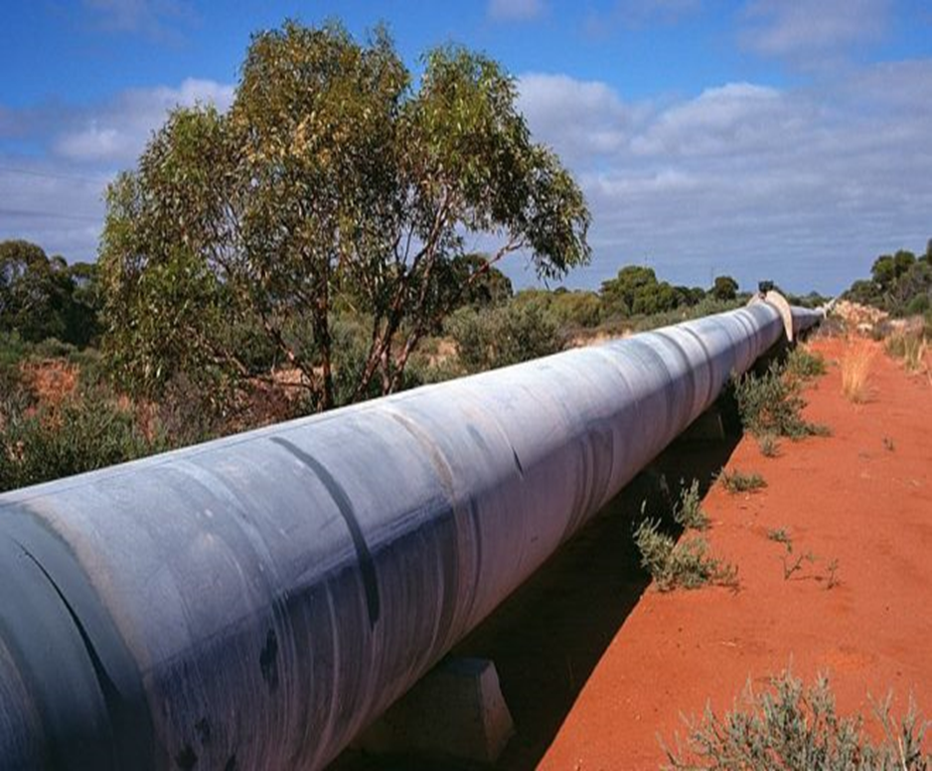
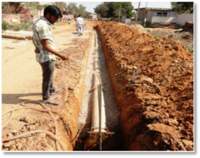

WATER RESOURCES DEVELOPMENT SECTOR
Having expertise to offer Consultancy Services in Water Sector
on Pan India and in a few selected Foreign Countries
To support the Client for Effective Implementation of various Water Sector Projects such as Urban Water Supply, Rural Water Supply, Associated Infrastructure, Major Irrigation Projects such as Dams, Reservoirs, Canals, Lift Irrigation, Tunnels and etc under Guidelines of JJM / Govt / ULBs / Funding Agencies
Services Covered are as indicated below:
Pre-tender Studies & Analysis Report | Detailed Designs, Drawings & Estimates
Design Review / Cost Engineering | Assistance in obtaining Clearances
Work Methodology & Time Management | Quality Control and Assurance
Contract Management & Claims handling | Support for O&M, and Closure achievement
Transwat Techno-Engineering Services Ltd

Slide 12

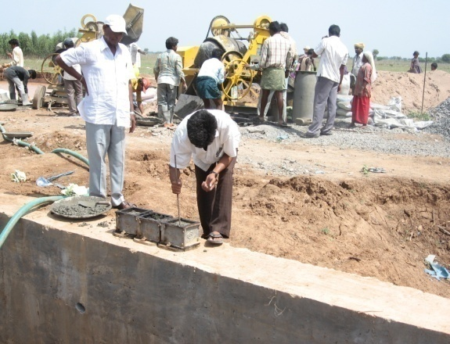
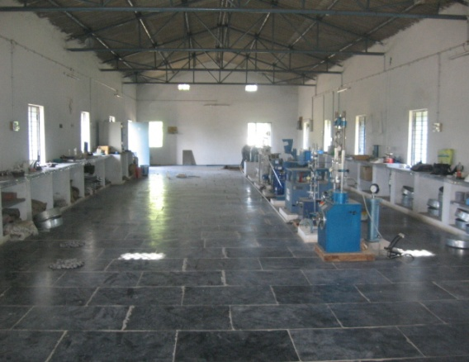

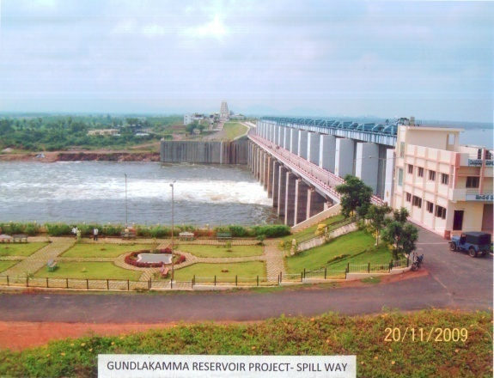

Govt. of Andhra Pradesh (Erstwhile Combined State) | Introduction of Third Party Quality Control / Quality Assurance (TPQC/QA) Consultancy in Irrigation Projects in Andhra Pradesh
Irrigation & CAD
Govt. of Andhra Pradesh (Erstwhile Combined State) has taken up a massive construction programme during 2004-05, called “JALAYAGNAM”, of Major Irrigation Projects all over the State, viz., Dams, Reservoirs, Tunnels, Canals, Lift Irrigation and etc
Large Scale Projects are covered under 10 different Consultancy Agreements, wherein Consultants’ responsibilities are to review Designs of various projects covered in 69 EPC Projects, & to maintain multi-level QC procedures so as to assure Quality in above said projects, with continuous supervision; Among Contract Management Procedures viz., Project Co-ordination Services, Project Management, Construction Management, and Third Party Quality Control Consultancy (TPQC), TPQC Consultancy is most economical and ideal system suitable for these Projects.
This programme envisaged deployment of huge resources at short notice, particularly Technical Experts, Engineers, Central Labs at project HQs / Field Labs / Mobile Labs at work sites so as to monitor quality aspect; Coul successfully mobilise and maintain over 400 Engineers for the subject projects
Project components includes Canals, Reservoirs, Dams, Lift Irrigation Schemes and other related structures. Projects allotted to our company include over 10 Reservoirs, 4 Dams, 3 Tunnels (of which two with TBM, of a length of 18 Kms each of which 7.5 KMs each completed in our tenure), Lift Irrigation Schemes, Main canals and relates structures etc
Transwat Techno-Engineering Services Ltd

Slide 13

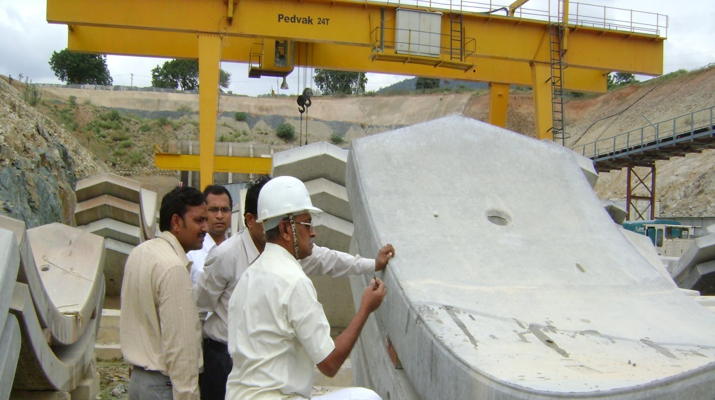
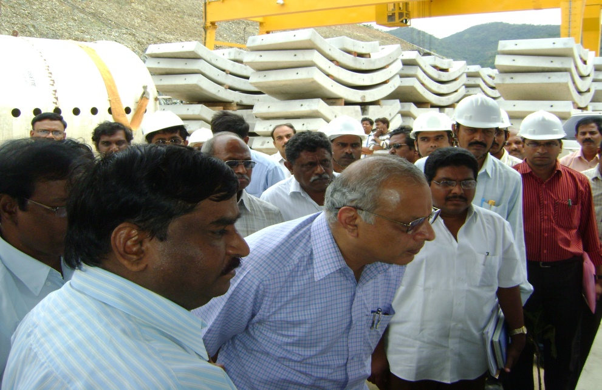
DESIGN REVIEW OF TUNNELS PROJECTS in the erstwhile combined State of Andhra Pradesh
Tunnels in the erstwhile combined state of
ANDHRA PRADESH
Checking the Epoxy grouting done in Tunnel - I
Senior officials inspecting Tunnel – II
Tunnel – I:- (18,820mts)
Tunnel boring work is stopped from 1.11.12 on wards due to booster erection in the Tunnel and maintenance of cutter head at Tunnel boring machine.
Tunnel drilling for about 1681mts from exit was completed from 1.04.12 to 31.03.13.
Total Tunnel boring length completed so far is 8165mts against 18820mts up to 31.03.13.
Segments Plant:-
Segments casting work is stopped due to fill of segment yard at segment plant and booster erection in the Tunnel.
The casted segments so far are 5703Nos. from (01.04.12 to 31.03.13) and total cumulative 23431Nos as against 47050 Nos (i.e., 31.03.13) Total 14 Nos of defects are identified out of there 11 Nos of defects are rectified in our tenure
Tunnel – II (18,820mts):-
Tunnel drilling for about 2970km from exit was completed and work stopped from 1.04.12 to 31.03.13 and Tunnel boring work is in progress. In the Tunnel Boring Machine the boring operation is carried out at an average of 6 to 8mts daily as a progress.
The strata came from muck is usually quartz and the total Tunnel boring length 7376 mts against 18838mts up to 31.03.13
Segments Plant:-
Segment Plant work (i.e.,) manufacturing of reinforced concrete segments work is in progress and the casted segments so far are 11155 Nos (from 1.04.12 to 31.03.13) and total cumulative 34249 Nos as against 82250 Nos (i.e., 31.03.13).
Total 31 Nos of defects are identified out of these 13 Nos of defects were attended in our tenure
Transwat Techno-Engineering Services Ltd

Slide 14

Brief description of TUNNEL–I & TUNNEL - II
Sl. No. Description of Item Tunnel-I Tunnel-II
1. Length of Tunnel 18820 Mts 18838 Mts
2. Diameter of Tunnel 7.00 Mts 9.20 Mts
3. Discharge 85 Cumecs 243 Cumecs
4. Bed Fall 1 in 1294 1 in 1096
5. Length of Exit Channel 100 Mts 200 Mts
6. Length of Link Channel 580 Mts 625 Mts
7. F.S.L. at Inlet + 261.142 M + 265.232 M
8. F.S.L. at exit + 246.628 M + 248.050 M
9. Sill level at inlet + 256.032 M + 256.032 M
10. Sill level at Exit + 241.518 M +238.850 M
11. Water can be drawn + 256.332 + 256.332
12. Forest Land Required 47.55 Ha 59.36 Ha
Checking the Epoxy grouting done in Tunnel - I
Senior officials inspecting Tunnel – II
Transwat Techno-Engineering Services Ltd

Slide 15
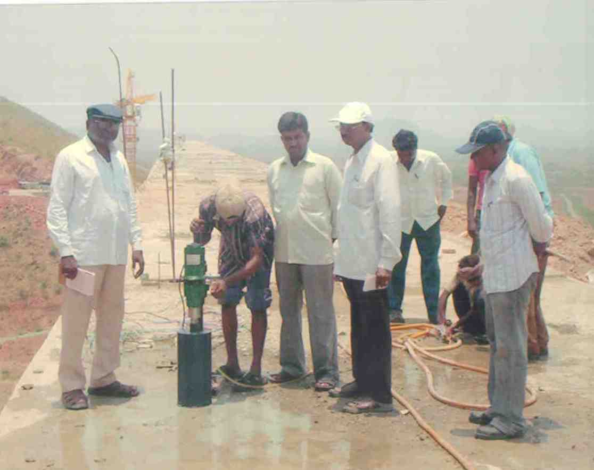
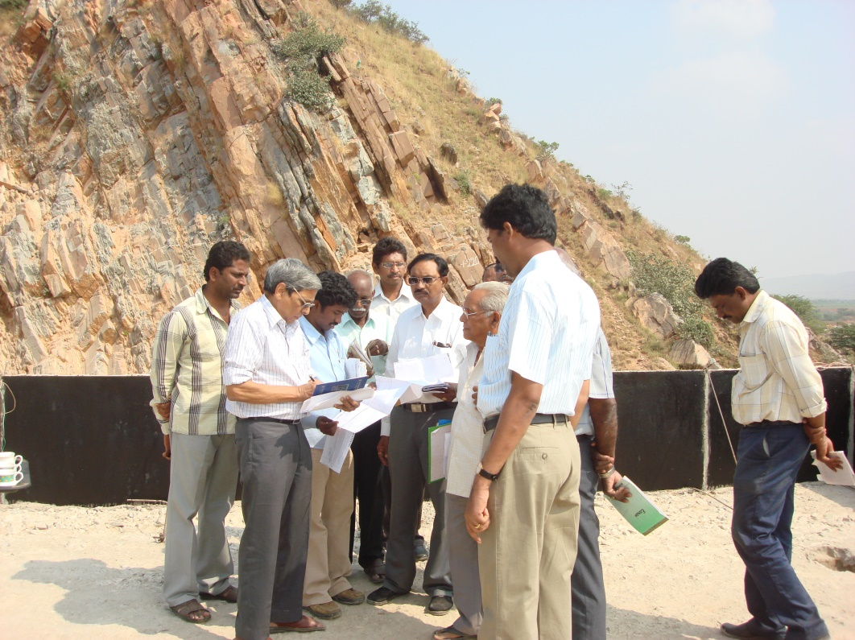
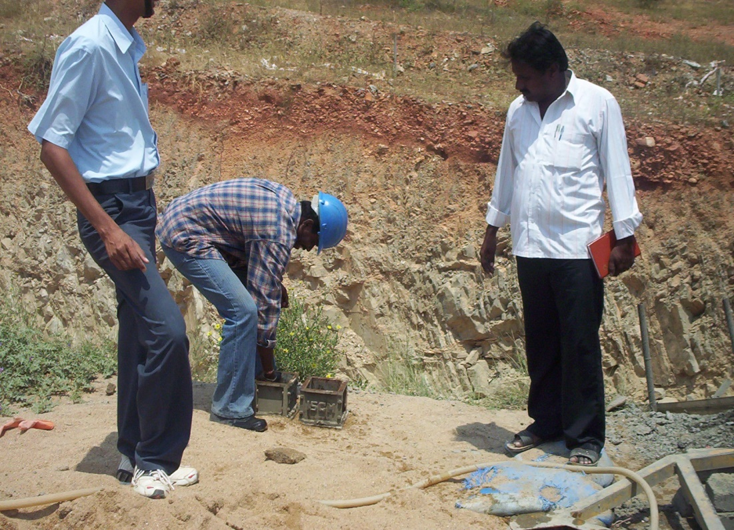
DESIGN REVIEW OF DAMS in the erstwhile combined State of Andhra Pradesh
Sunkesula Dam
Kakarla Dam
Gottipadia Dam
Placement of Concrete for NOF Dams are being checked continuously duly observing procedures for green cutting, clearing and cleaning the site, applying bituminous coat to the sides of the block junction points, compaction by sufficient vibration and applying chembond for dry surface. The observations made in this regard are communicated to the concerned Engineers regularly.
Calibration of Batching plant and other Lab equipment of EPC Agency is being checked periodically along with departmental and other officers as and when necessary and the reports being submitted to Engineer in charge.
Steel samples are being tested at SRBC laboratory Nandyala, Kurnool (Dist) JNTU Engineering College, Ananthapur. Steel reinforcement is being checked QC/QA team before placement of R.C.C.
Instrumentation in NOF Dams is being checked along with construction staff at the time of fixing the instruments.
Drilling & grouting works are being checked along with construction staff. Extra holes on all the blocks, got drilled, and observed permeability in addition to the regular drilling pattern as per GSI reports. Curtin grouting is in progress at preliminary holes, in foundation of the Dam as per GSI recommendations.
Sl. No. Name of the Total Length Max Height No of
NOF Dam of the Dam of the Dam Blocks
1. Sunkesula NOF Dam 378.50 Mts 59.652 Mts 16 Nos.
Kakarla NOF Dam 356 Mts 60 Mts 19 Nos.
Gottipadia NOF Dam 587 Mts 86.14 Mts 24 Nos.
Transwat Techno-Engineering Services Ltd

Slide 16
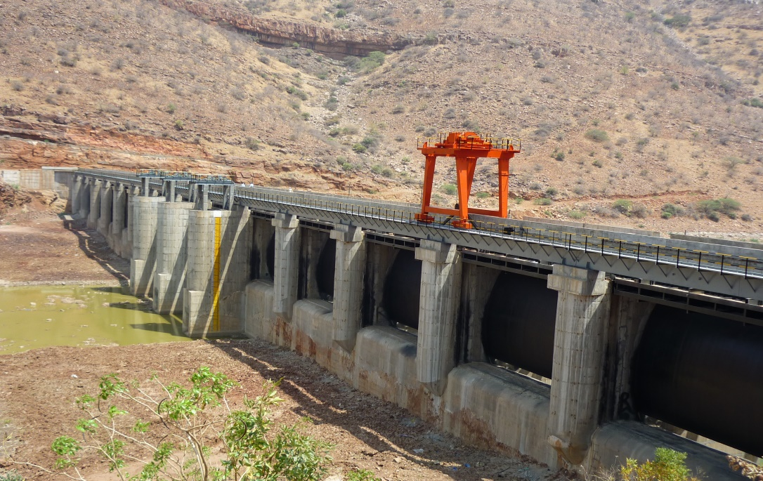
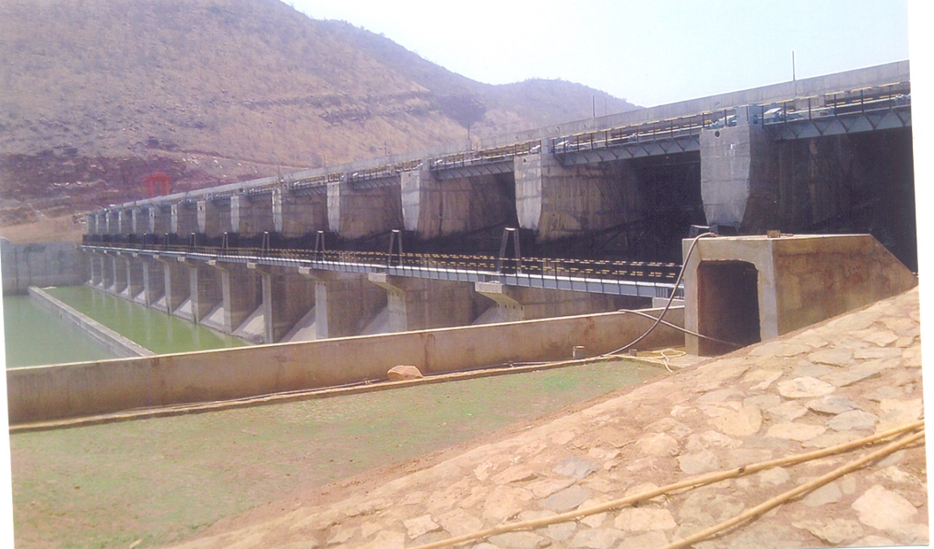
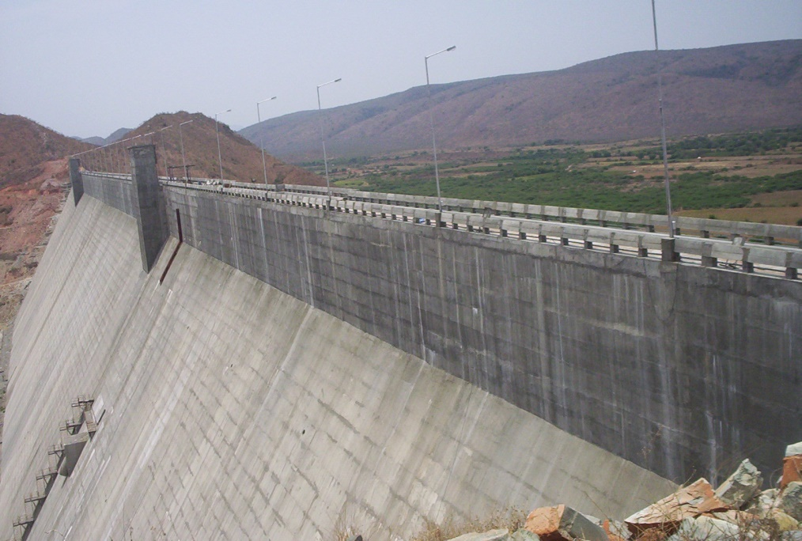
DESIGN REVIEW OF DAMS in the erstwhile combined State of Andhra Pradesh
U/s view of Gandikota dam
D/s view of Gandikota dam
Catchment area | 19197 Sq. Km
Water spread area at FRL | 109.35 Sq.Km
Gross Storage capacity | 26.85 TMC
Live Storage capacity | 22.300 TMC
Maximum flood discharge | 8180 Cumecs
FRL | +212.000 M
MWL | +212.000 M
TBL | +215.000 M
Length of spill way | 320 M
No. of gates with sizes | 14 Nos 15 M x 9.80 M
Gandikota dam is completed; control room only to be constructed. For radial gates, ultrasonic tests for welds are conducted by the T.P.Q.C. and no defects in welds are found.
The radial gates were tested for their travel up and down and their functioning under no load condition is satisfactory. On load i.e., when there is water tests are to be conducted for their functioning.
Transwat Techno-Engineering Services Ltd

Slide 17
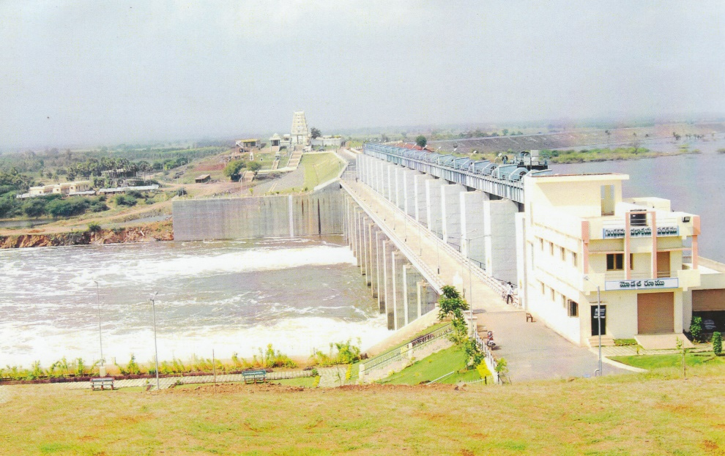
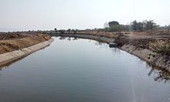
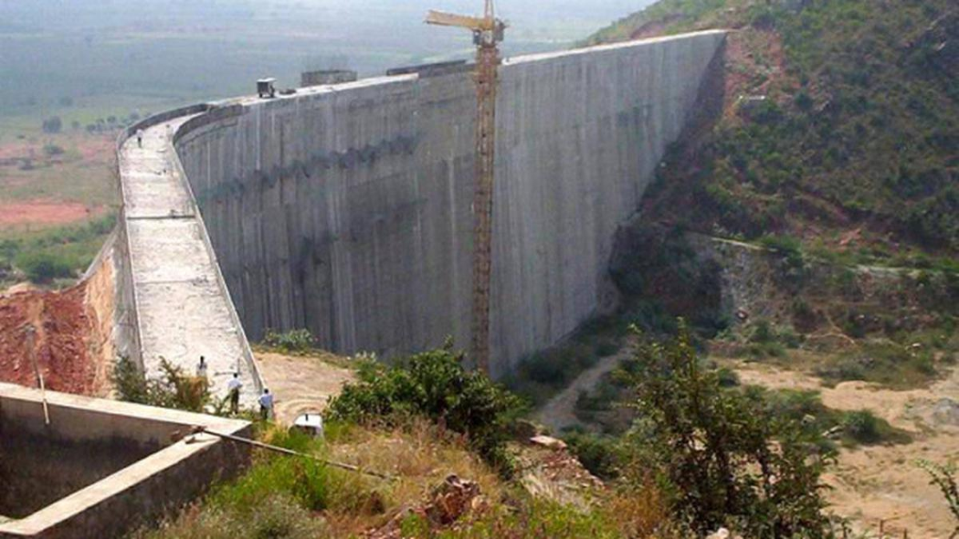
DESIGN REVIEW OF RESERVOIRS in the erstwhile combined State of Andhra Pradesh
Gundlakamma Reservoir
Canal to Gandikota Reservoir
Velugodu Reservoir
Static lift head : 77.00 M [+204 to +281]
Total Lift Head : 88.30 M
Water to be lifted : 6.00 TMC
Number of pumping days : 67 days
Capacity of each Pump : 5030 HP
Discharge of each pump : 3.237 Cumecs[114 C/S]
Total discharge of 9 Pumps: 29.14 Cumecs[1029 C/S]
Self Catchment : 20 Sq. KM
TBL : +285.000M
MWL : +281.600M
FRL : +281.000M
MDDL : +243.500M
Length of the Bund : 3.668 KM
Transwat Techno-Engineering Services Ltd

Slide 18
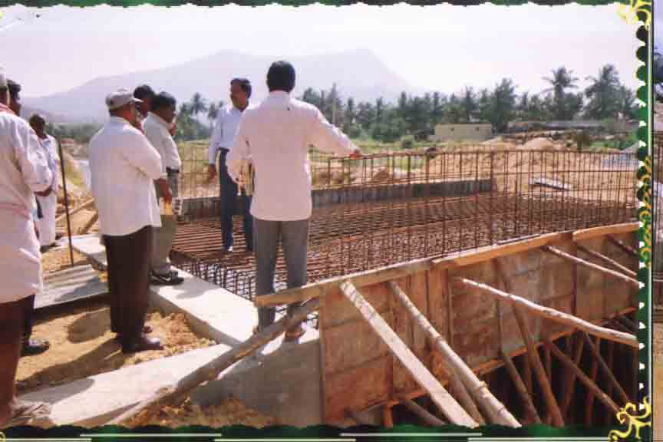


DESIGN REVIEW OF CANALS in the erstwhile combined State of Andhra Pradesh
Inspection by Executive Engineer, HNSS Division, Kadiri
HNSS Main Canal :
Canal Discharge starting +21.15 Cumecs
Canal Discharge ending +21.15 Cumecs
C.B.L starting +475.500 M
F.S.L starting +460.00 M
Bed Width 6.75 M
F.S.D 2.5 M
Surface fall 1 in 8900
Side slopes 1.5: 1
Velocity 0.83M/sec
Sl. No. Name of the Total Length of Completed Balance Ayacut in Acres
Canal canal in Km length in Km length in Km
Punganur Branch C 71.33 61.95 9.38 49000
Neeva Branch Canal 132.15 128.76 3.39 57,500
Vayalpadu Branch C 23.5 23.5 0 17,200
Transwat Techno-Engineering Services Ltd

Slide 19



Micro Lift Irrigation Project
Command Map of Khalwa MLIS
Planning & Research:
Detailed study of already executed & under execution projects is done before to identifying cost guiding factors and to find the possible solutions to obtain optimum sketch of the project.
Our experience in various Piped Irrigation Network (PIN) projects across the country have been rendered in optimizing this project.
CPHEEO Manual and Piped Irrigation Network design guidelines by CWC and all the required IS codes have been thoroughly referred at all stages of this work.
Despite of time crunch, our engineers and surveyors visited the source & DC points of the scheme and the best locations for the both intake and DC are identified after thorough enquiry and study.
Based on the geographical conditions two different options to serve the required area is proposed for this scheme and the key plans for the both options is as shown below.
Transwat Techno-Engineering Services Ltd

Slide 20


Micro Lift Irrigation Project
HEAD WORKS
Layout of Pump Station-1
Transwat Techno-Engineering Services Ltd

Slide 21


Rural Water Supply Project (under JJM)
The Distribution network shall be designed using sophisticated soft wares such as EPANET & Water Gems / other convenient soft ware.
Network Modeling Philosophy:
Distribution network shall be designed for each scheme separately by covering each and every household, commercials places, educational institutions and government offices.
The disnet planning shall be done such that each household is connected with the minimum network length.
The optimization of the diameters of the disnet shall be achieved without compromising the terminal residual head of 7m.
Minimum velocity in the Disnet is adopted as 0.40m/s. while the maximum velocity shall be capped at 1m/s.
The head loss in both disnet and rising mains shall be calculated using Hazen-Williams formula by taking the roughness coefficient ‘C’ value as 145 for HDPE pipes shall be 140 for DI pipes.
Minor losses due to bends and other fittings shall be included.
Transwat Techno-Engineering Services Ltd

Slide 22










Water Supply / Storm Water / Sewerage Projects
Transwat Techno-Engineering Services Ltd

Slide 23

FOR ENQUIRIES, PLEASE CONTACT
M Sridhar Reddy : +91 98858 09317 (Director)
Email : reddy@transwat.com
H Charles Sunny : + 91 9000 347 257 (Business Head)
Email: bd@transwat.com
TRANSWAT TECHNO-ENGINEERING SERVICES LTD
(Formerly WADIA TECHNO-ENGINEERING SERVICES LTD)
Regd. Office:
A-201, Upsahra lane, Shree Arham Bluz, C D Barfiwala Cross Lane, Andheri (W) , Mumbai - 400058.
Tel : 022- 44545653; 98858 09317 Email : bd@transwat.com ; www.transwat.com
Corp. Office:
# 8-2-686/K/1&2, C-3, 2nd Floor, ‘Kimtee Square’, Road No: 12,
Banjara Hills, Hyderabad – 500 034
Phone : +91 40 23320233; +91 98854 74414;
Email : bd@transwat.com ; reddy@transwat.com
Regional Office:
House no. 226 , Block No 3, Subhash Nagar,
New Delhi 110027Mobile : +91 92121 48400 / +91- 9885 74414
Transwat Techno-Engineering Services Ltd

